Slide 1
Bob Bickford, Associate Director Replant
Windows of Revitalization

Slide 2
PARTNERSHIP IS NEEDED
47,000 SBC Churches
85% need at least to be revitalized
10-15% need to be replanted
44,650 churches require some sort of assistance, intervention or renewal

Slide 3
Windows of Revitalization
Background
Churches experience life stages

Slide 4
Windows of Revitalization
Background
Churches experience life stages
Birth
Adolescence
Maturity
Decline
Death (churches need not die)

Slide 5
Windows of Revitalization
Background
Churches experience life stages
Each stage has unique characteristics/challenges

Slide 6
Windows of Revitalization
Background
Churches experience life stages
Each stage has unique characteristics/challenges
Leadership tasks/requirements change with each stage

Slide 7
Windows of Revitalization
Background
Churches experience life stages
Each stage has unique characteristics/challenges
Leadership tasks/requirements change with each stage
Every church and its leaders must be aware of their present stage and lead according to the challenges/needs they are experiencing

Slide 8
Windows of Revitalization
Background
Churches experience life stages
Each stage has unique characteristics/challenges
Leadership tasks/requirements change with each stage
Every church and its leaders must be aware of their present stage and lead according to the challenges/needs they are experiencing
Many Churches fail to address core issues needing renewal

Slide 9
Why are CHURCHES declining?

Slide 10
Why do Churches Decline?
Study after study reaches the same conclusion: there is no single cause or simple pattern of causes related to church growth or decline.
- Dean R. Hoge and David A. Roozen, Understanding Church Growth and Decline, 1950-1978 (New York: Pilgrim Press, 1979), 39.

Slide 11
Why do Churches Decline?
Single cause explanations of the [religious] trends attract attention. But to explain them by any one factor alone oversimplifies an exceedingly complex set of relationships. Thus we look not to single-factor explanations, but to the impact of multiple factors whose interrelationships we cannot trace out or understand.
- Jackson W. Carroll et al., Religion in America, 1950 to the Present (San Francisco : Harper & Row, 1979), 37.

Slide 12
Why do Churches Decline?
(Eymann’s Factors)
Inadequate pastoral leadership
Loss of vision
A changing community (demographics)
An aging congregation
Inward focus (lack of outreach)
Resistance to change (traditionalism)
Power struggles (internal politics)
Church split (divisiveness)
Inadequate facilities
Spiritually unhealthy (no growth process)
Low morale (discouragement)

Slide 15
How do we ARREST and REVERSE the death and decline rate?

Slide 16
FIRST, TREAT DECLINE AS A SPIRITUAL PROBLEM

Slide 17
ENGAGE IN STRATEGIC ACTIONS SECOND

Slide 18
CHURCH
LIFECYCLES

Slide 19
Plateau
Maturity
Decline
Church Life Cycle
Growth
Death

Slide 20
COVID
Maturity
Decline
Growth
Death

Slide 21
Dream
Church Renewal Cycle
Decline
Maturity
Growth
Death

Slide 22
Average Church
Life Cycle
3yrs
5-7yrs
20-50+ yrs

Slide 23
How?
how are we
doing?
What?
Why?
what do we
need to do?
why are
we declining?

Slide 24
What approach is needed?
Revi
Church Growth
Replanting

Slide 25
Revitalization
Church Growth
First Revitalization Window
Replanting

Slide 26
Revitalization
Church Growth
Revitalization
Replanting
Second Revitalization
Window

Slide 27
Revitalization
Revitalization
Church Growth
Replanting
Replant
Window

Slide 28
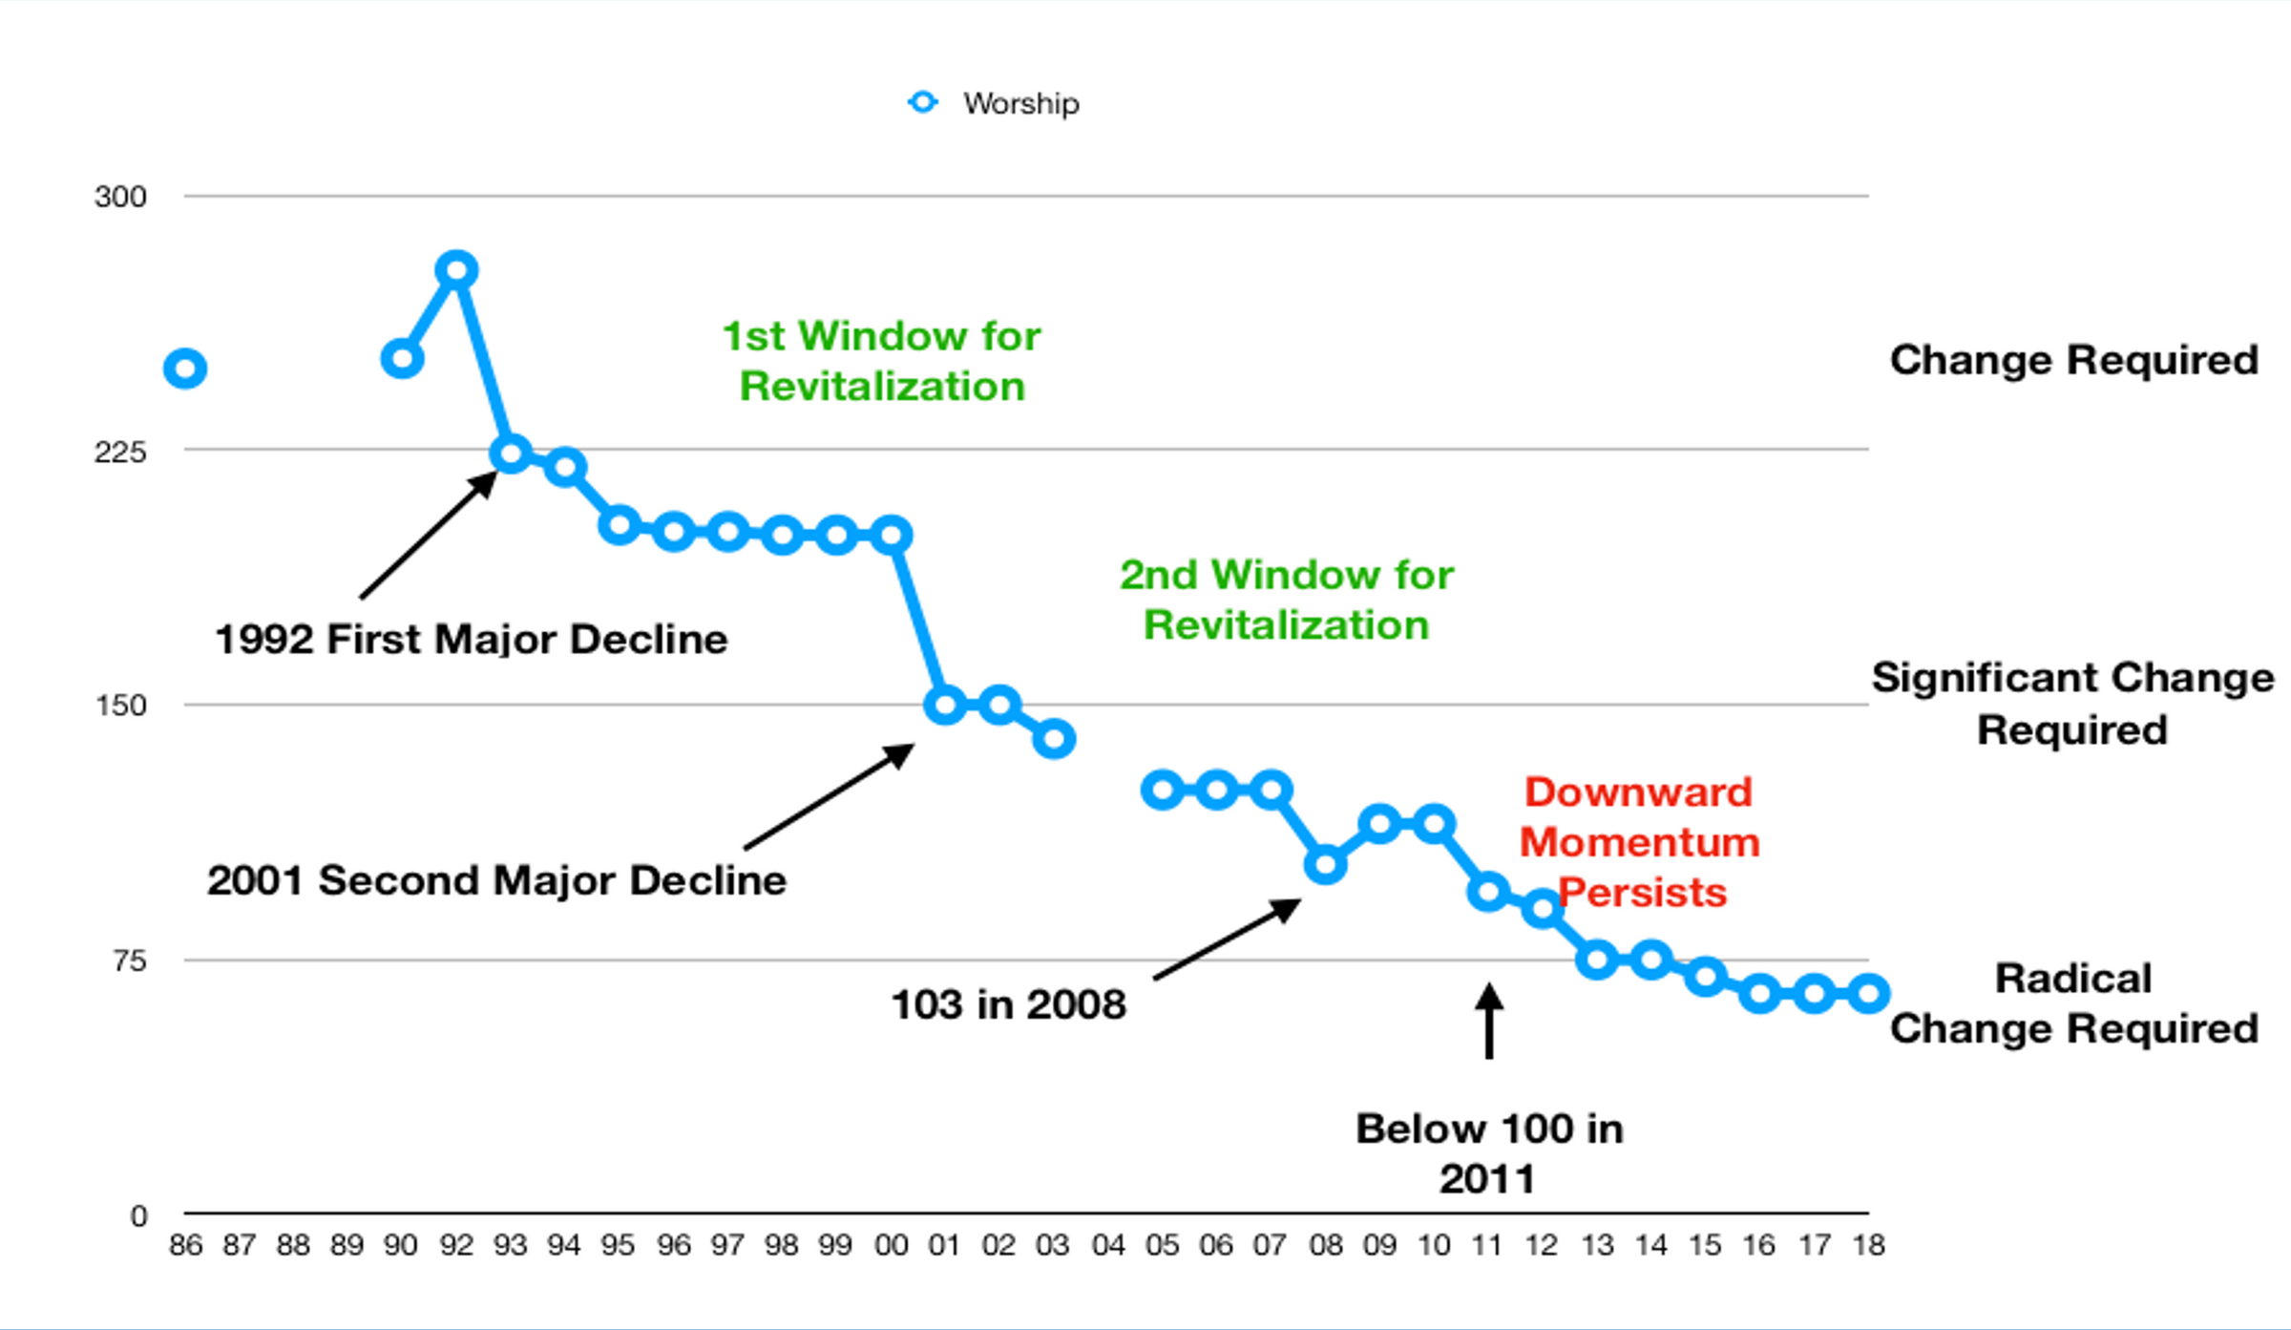

Slide 31
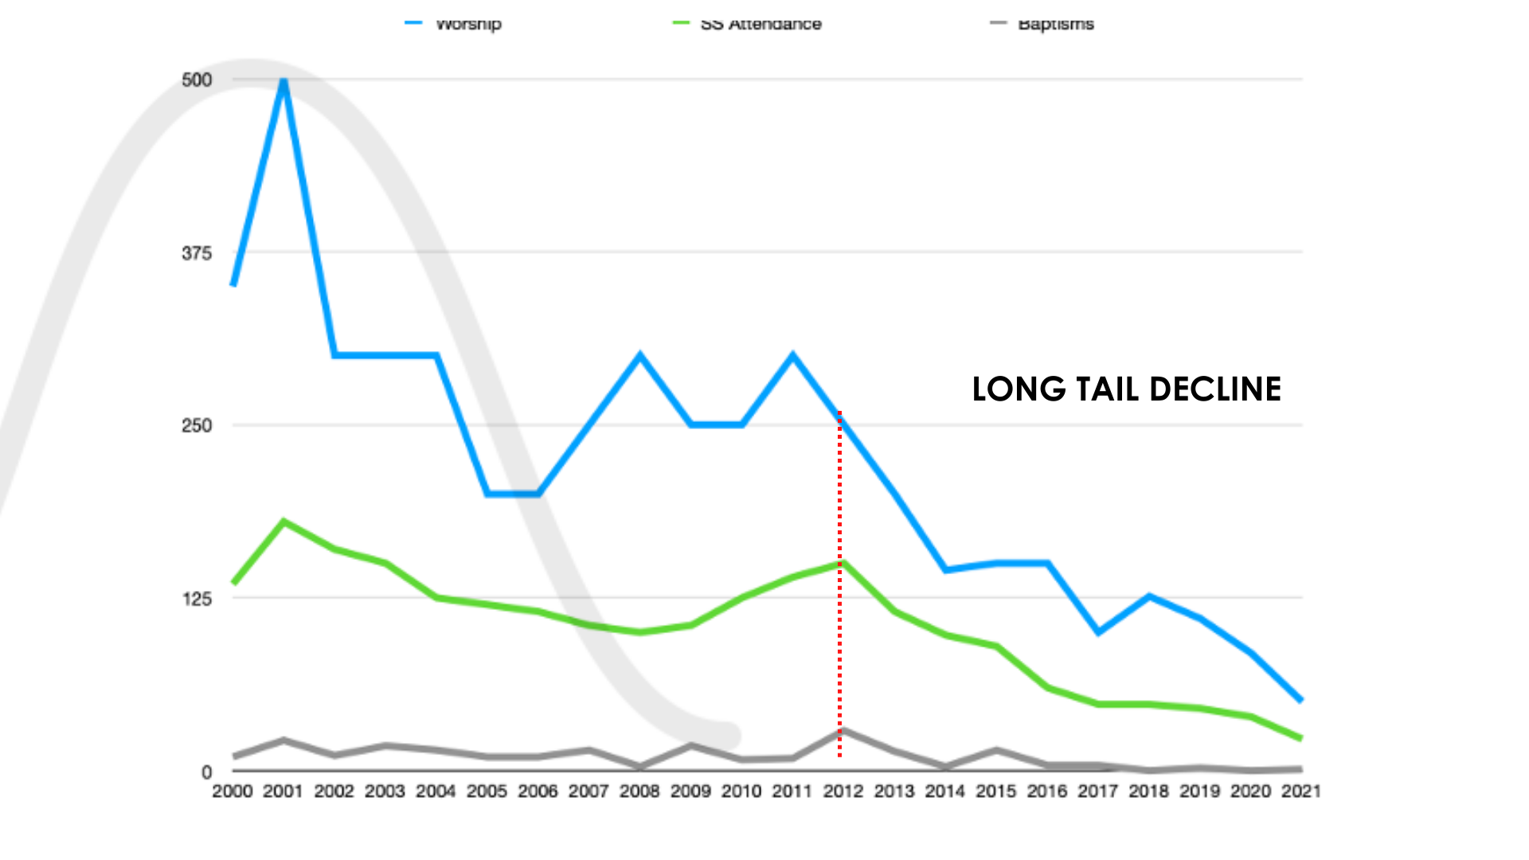

Slide 32
Plateau
Revitalization
Maturity
Assisted Revitalization
Covenant Revitalization
Replant from Within
Partnership Replant
Growth
Closure/Donation
Death

Slide 33
LONG TAIL DECLINE
Common Characteristics
Inability or unwilling to engage missionally
Revitalization leaders absent (aged congregation)
False hope syndrome (1 visitor / some children)
Mission Shift: from great commission to keep services going
Enough money to fund the mission shift-even though it’s decreasing
Building blind: facilities are not welcoming or desirable to outsiders

Slide 34
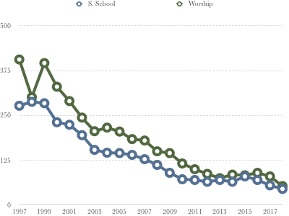
Sunday School and Worship Attendance

Slide 35
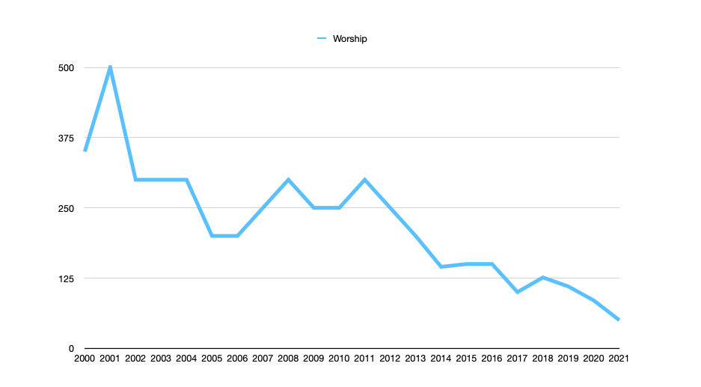

Slide 36
A DELIBERATE, DEDICATED AND PROTRACTED EFFORT TO REVERSE THE DECLINE OR DEATH OF AN EXISTING CHURCH.
REVITALIZATION

Slide 37
REVITALIZATION = EXISTING CHURCH + EXISTING LEADERS + EXISTING STRUCTURE + HISTORY/LEGACY + RENEWED/NEW EFFORT

Slide 38
THE LEAST INVASIVE APPROACH
USES EXISTING (EVERYTHING)
REVITALIZATION
CHARACTERISTICS
LESS CHANGE UPFRONT
REQUIRES A LONG TIME PERIOD
HIGH RISK: CAN BE STOPPED
LEAST EFFECTIVE IN BRINGING NEEDED CHANGE

Slide 39
REVITALIZATIONS
80% FAILURE RATE
-THOM RAINER

Slide 40
LACK COURAGE
HELD HOSTAGE
NO REVI LEADERS
MISSED"WINDOW”
PEOPLE VOTE “NO”
WHY
REVITALIZATION
FAILS

Slide 41
REPLANT
THE COURAGEOUS DECISION TO CLOSE AN EXISTING CHURCH AND RE-LAUNCH AS A NEW CHURCH

Slide 42
REPLANT = NEW LEADER + EXISTING PEOPLE + OUTSIDE PARTNERS + NEW PEOPLE + NEW STRUCTURES/APPROACHES + HISTORY

Slide 43
REPLANT TYPES
REPLANT FROM WITHIN
MARRIAGE/MERGER
ADOPTION/CAMPUS
FAMILY NETWORK

Slide 44
REPLANT TYPES
FOSTERING
CLOSURE/DONATION

Slide 45
QUESTIONS/DICUSSION
Windows of Revitalization

Slide 46
Questions?
replant@namb.net

